Slide 1
Core-Java Project
Bank Account Application
Name :- Virendra Chaure
Employee Id :- 194537
Github Link :
https://github.com/vbchaure/JavaProject

Slide 2
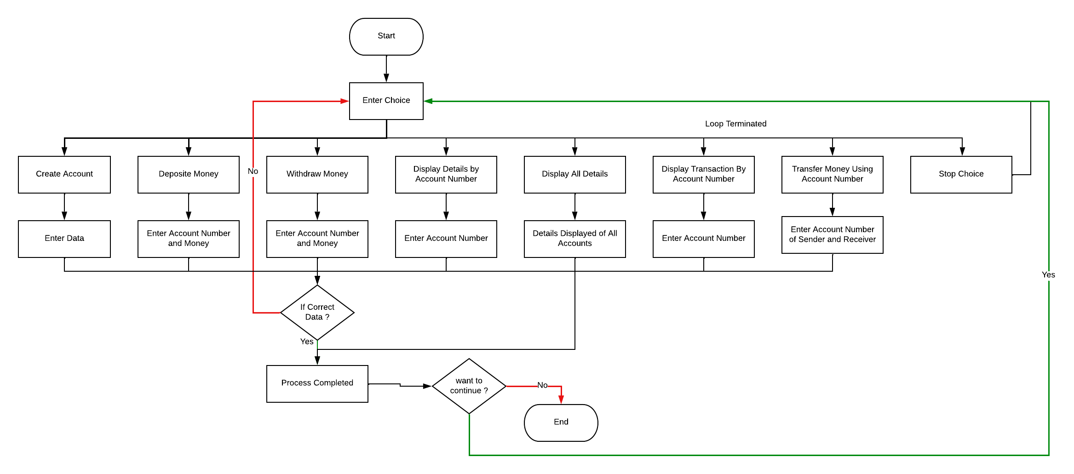
Flowchart

Slide 3
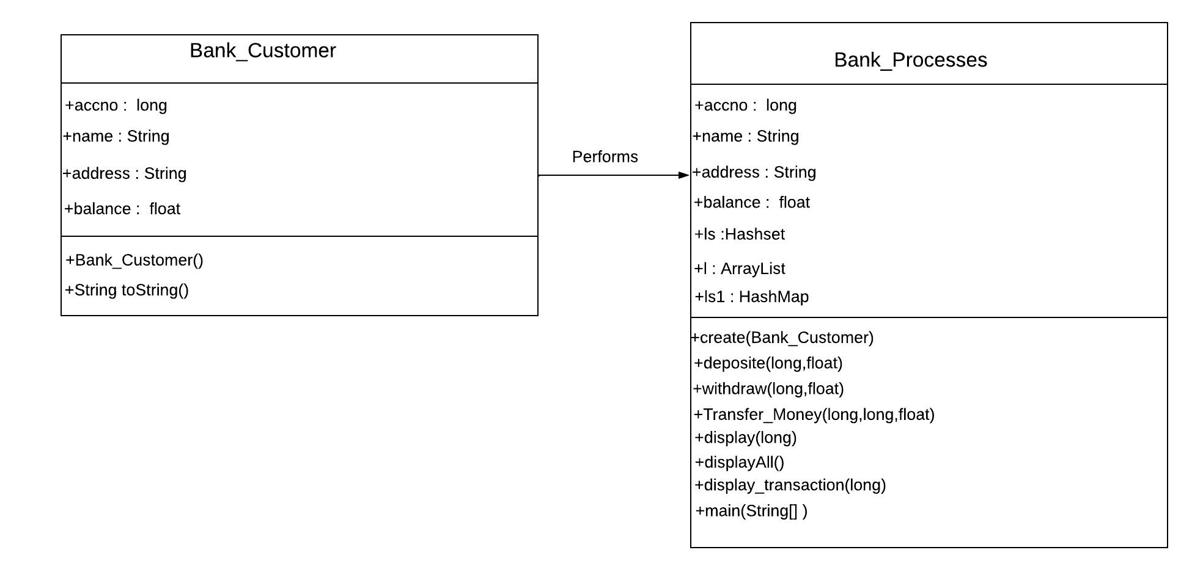
Class Diagram

Slide 4


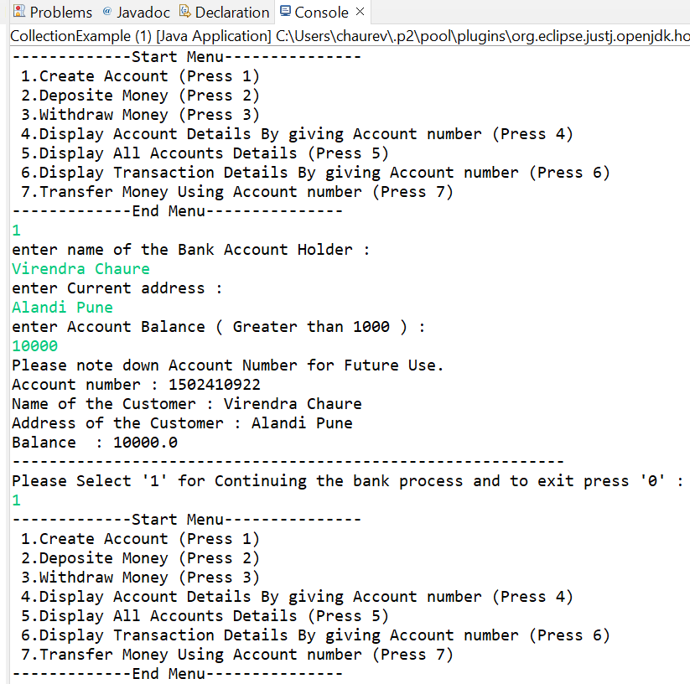



Output Screenshots

Slide 5
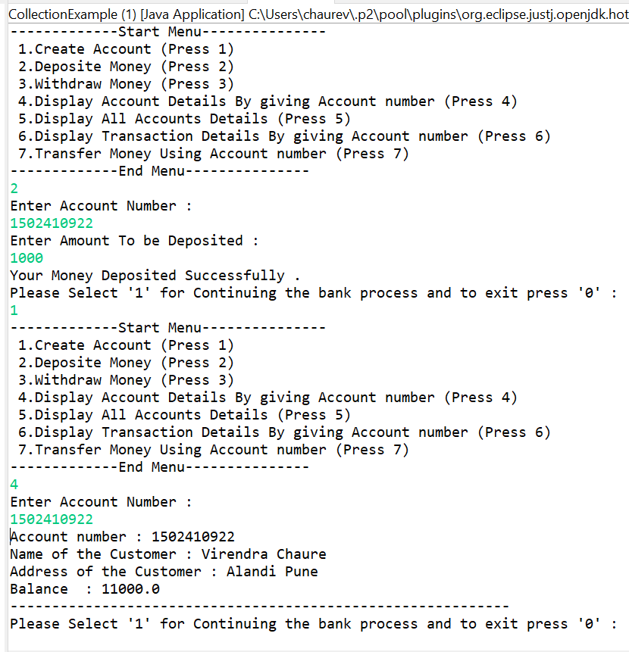
Output Screenshots

Slide 6
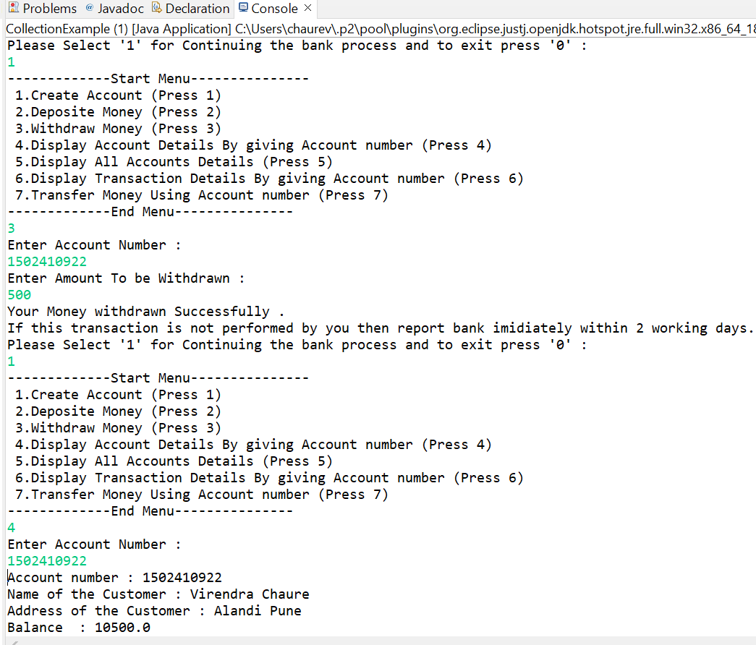
Output Screenshots

Slide 7
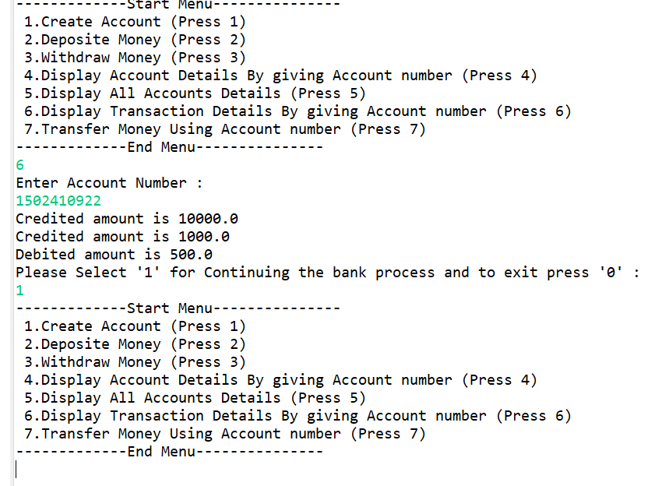
Output Screenshots

Slide 8
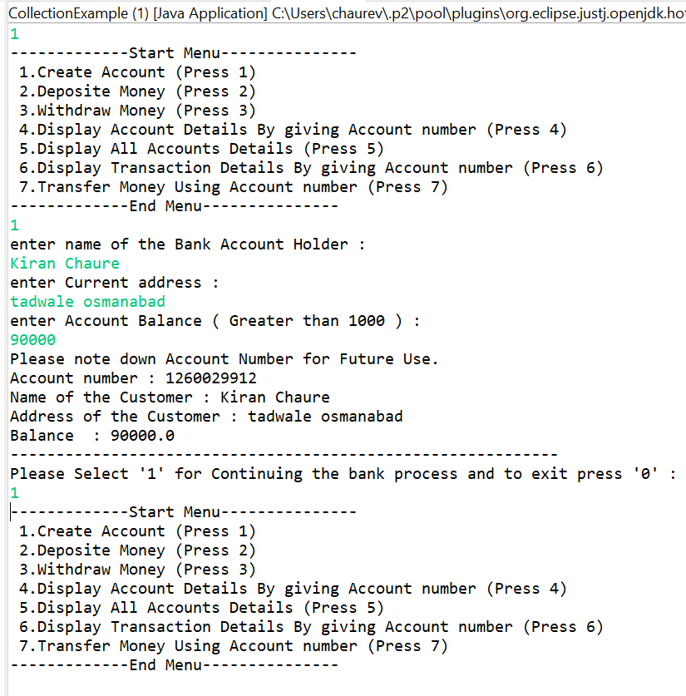
Output Screenshots

Slide 9
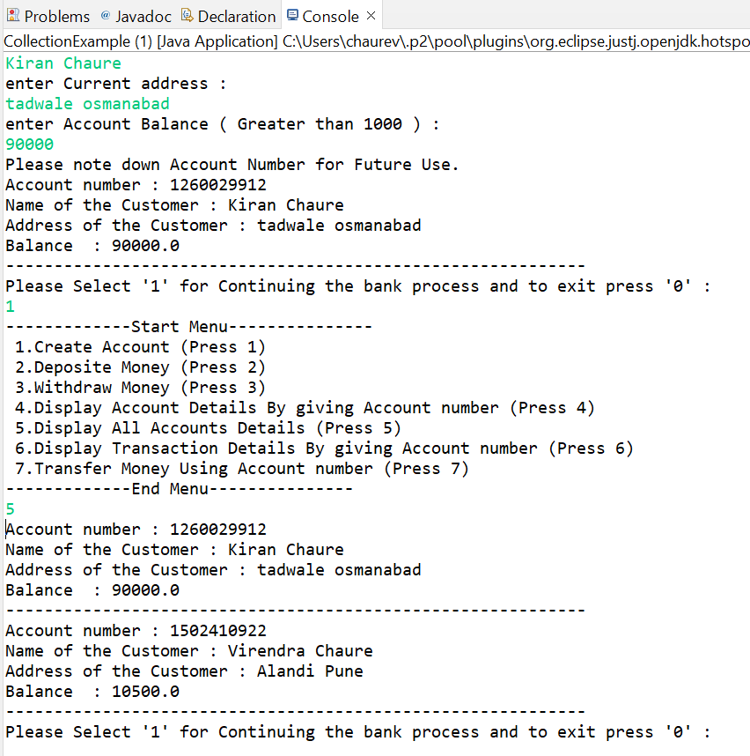
Output Screenshots

Slide 10
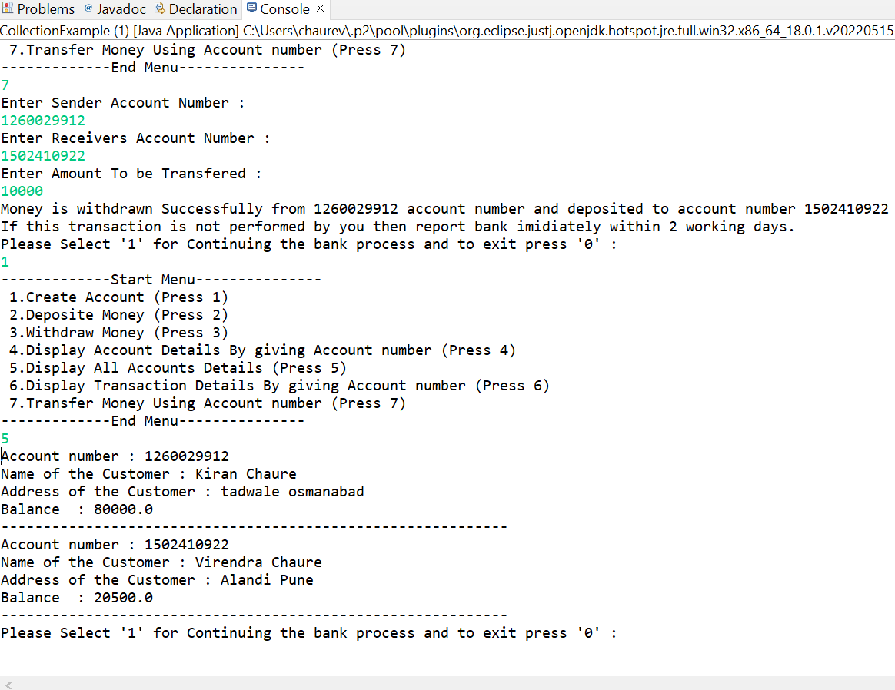
Output Screenshots

Slide 11
Thank You…!!! Any Questions ?

